Slide 1

Q2- Data Analysis Smart - 2023
Team 4 :
Ayman Adel Wahba
Osama Tarek Mohamed
Amira Gomaa Abdelaziz
Hajar Zakaria Emira
Supervised By:
Eng/Rana Salah
Eng/Toaa Gamal

Slide 2

Customer Churn Analysis

Slide 3
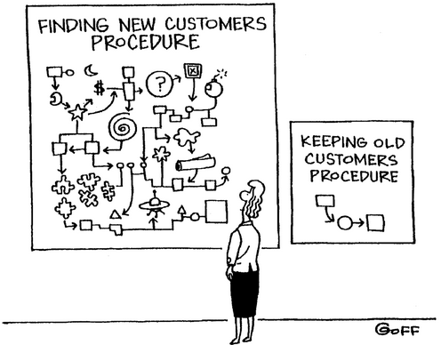
Reasons of churn Analysis:
the availability of service providers.
it costs five times as much to attract a new customer, than to keep an existing one.
the probability of selling to an existing customer is 60-70% percent while the probability of selling to a new customer is 5-20%.

Slide 4
Analysis process:
1- Modeling
2- Explanatory Data Analysis
3- Recommendations

Slide 5
Modeling (Preprocessing)
Missing data was random.
imputation was done by using K nearest neighbor and MICE(Multivariate imputation by chained equations).

Slide 6
Modeling (Choosing models)
The models used:
Logistic Regression (linear-parametric model).
XGBOOST models (gradient boosting tree-based model).
Reason of choosing the models:
The idea was to choose one linear/parametric model and one non-linear/non-parametric to capture any patterns in the data.

Slide 7
Modeling (evaluation metric)
Recall was used as an evaluation metric.
False Negatives (customers expected to not churn when in fact they churn).
False Positives (customers expected to churn when in fact they do not churn).

Slide 8
Modeling (evaluation metric)
Logistic Regression performed poorly 45%.
Xgboost performed well with a recall score of 90%.
Xgboost was chosen.

Slide 9
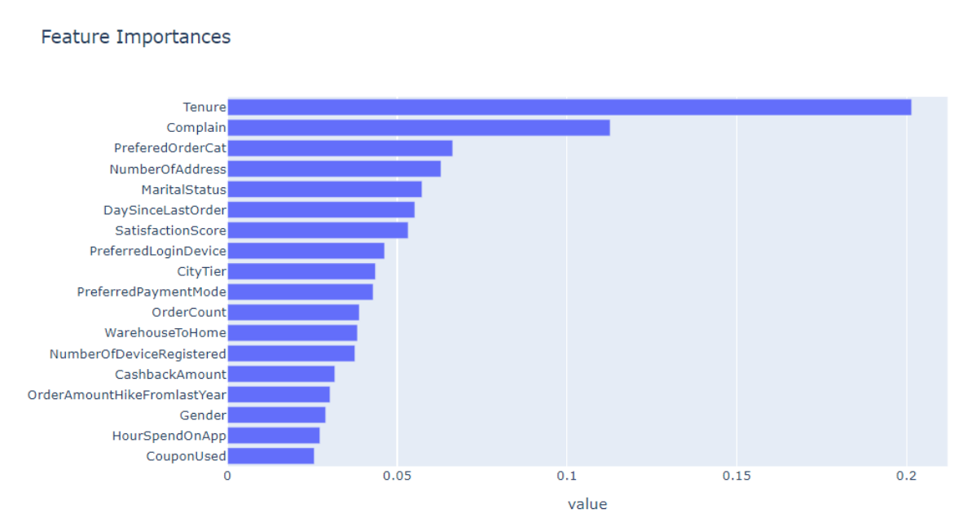
Insights
Feature Importance

Slide 10
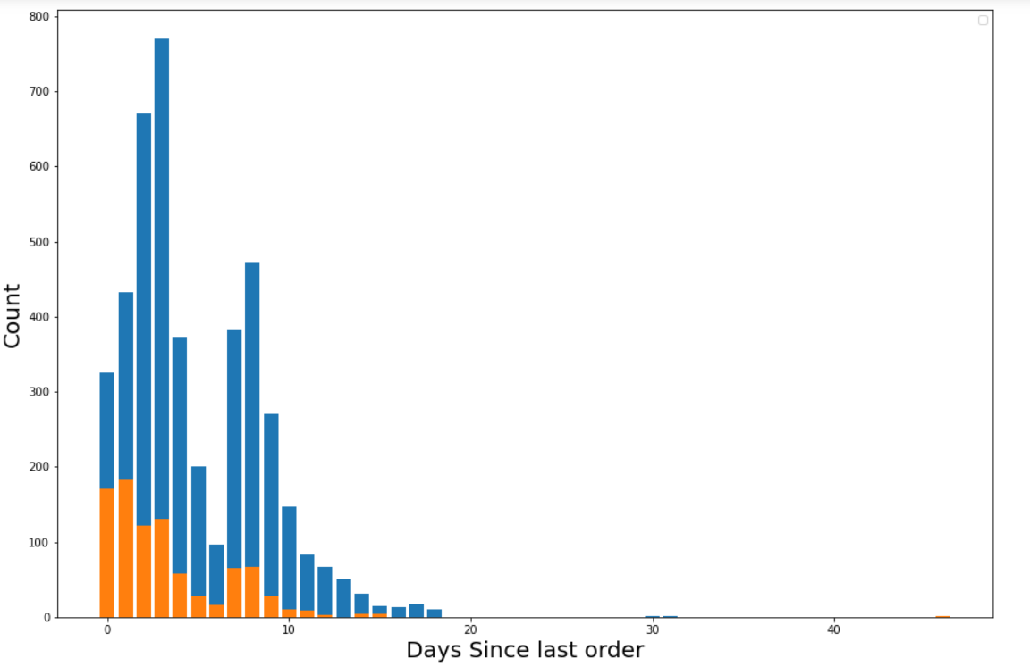
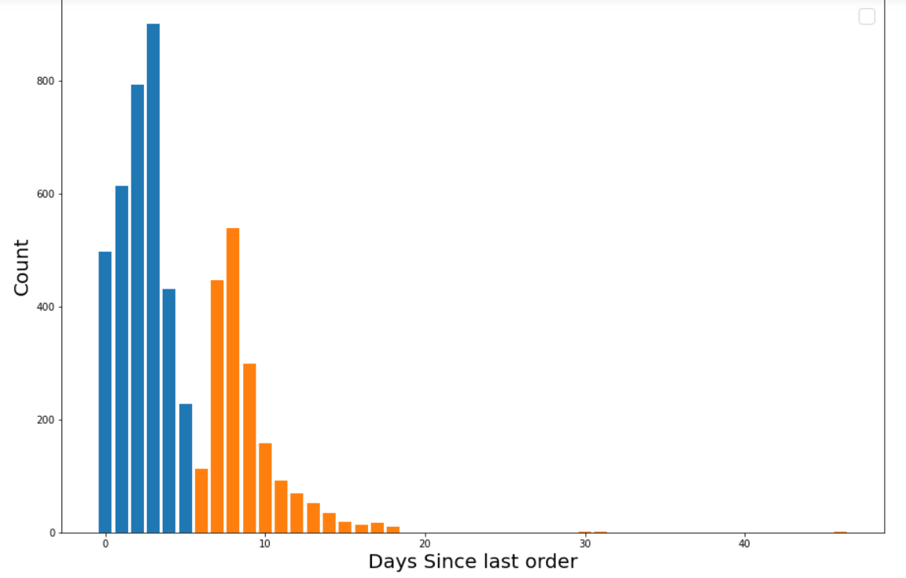
Insights
Segmentation by days of last order wouldn't be appropriate.

Slide 11
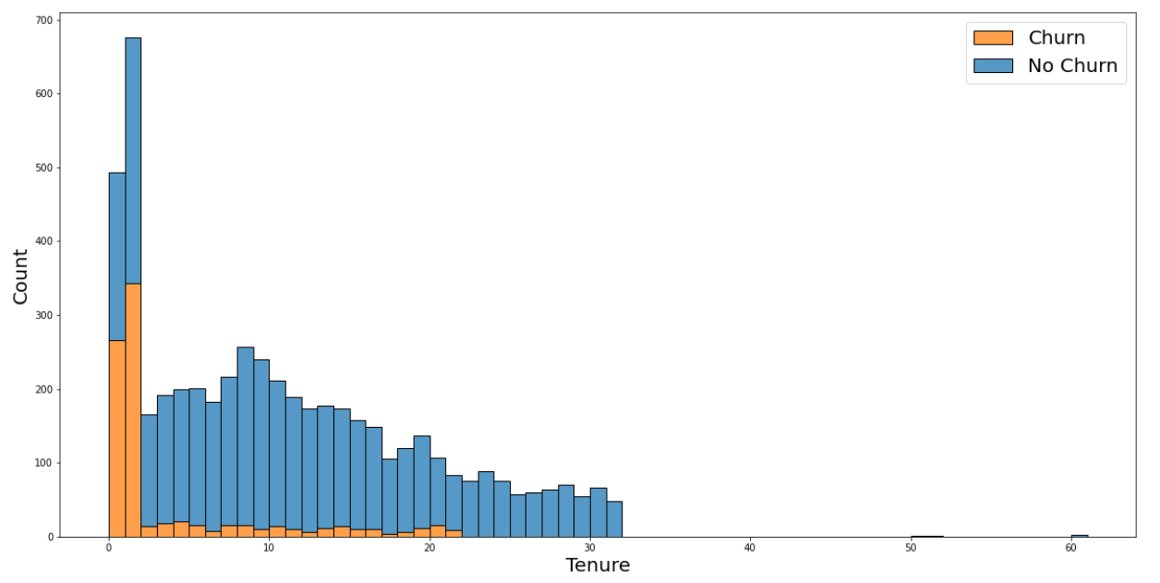
Insights
The relation between tenure and churn

Slide 12
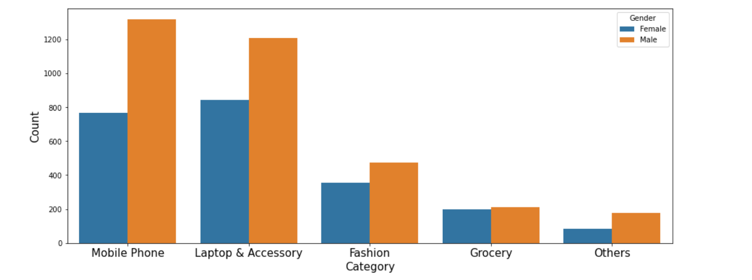
Insights
Is there any difference in the buying behavior of male and female customers?

Slide 13
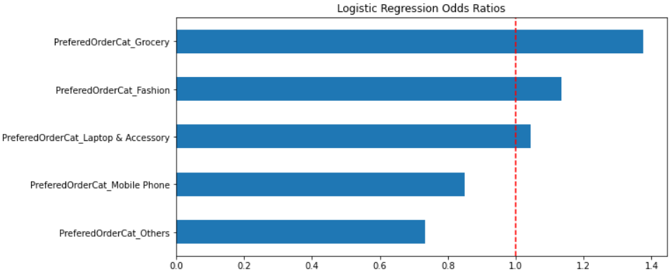
Insights
Logistic Regression – Odds Ratios

Slide 14
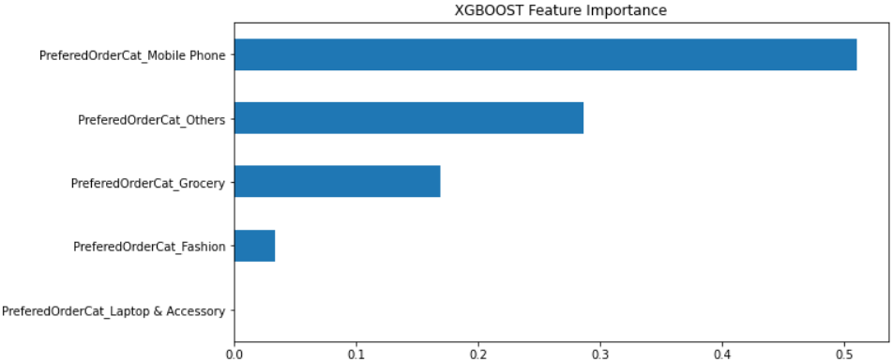
Insights
XGBOOST – Feature Importance

Slide 15
Insights
Logistic Regression Odds Ratios and XGBOOST Feature Importance Show that
Females are 1.4 times more likely to buy groceries.
Females are 1.1 times more likely to buy fashion products.
Males are 1.4 times likely to buy products in 'Other's category.
Males are 1.15 times more likely to buy mobile phones.
Almost no difference in the buying behavior of males and females when it comes to laptop & accessories.

Slide 16
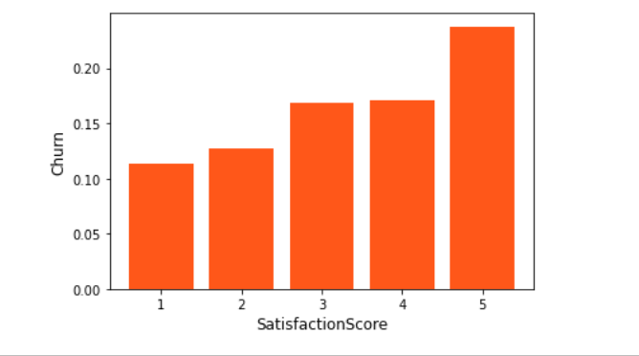
Insights
Satisfaction score:

Slide 17
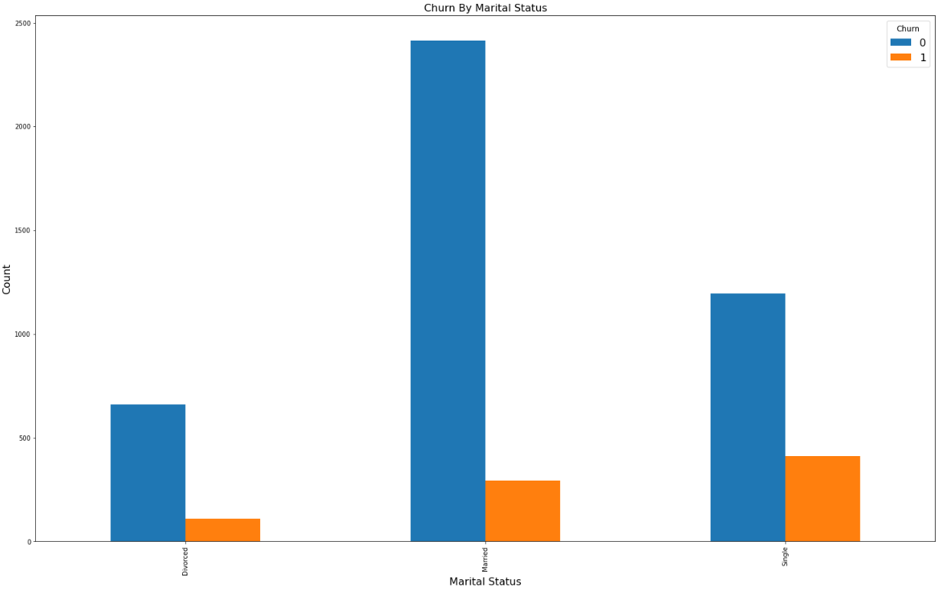
Insights
Marital Status:

Slide 18
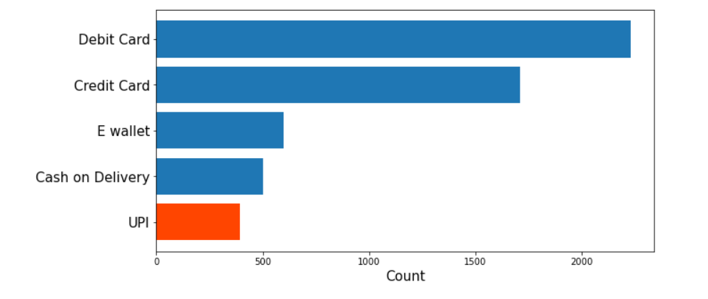
Insights
Preferred payment method:

Slide 19
Recommendations
Divide customers by Tenure into 3 segments
2month (volatile) , 3 to 22 (potential loyalists), 22+ (loyal customers)
Offer sales and promotions to female customers in categories of groceries and fashion.
Offer better customer service to customers and handle their complaints in an efficient manner
UPI as a payment method being easy to integrate, has few to no taxes and better for small to medium businesses.

Slide 20
Limitations
Couldn't find an answer as to why the satisfaction level of 5 is the highest in churn rate.
Insufficient information about the variable “City Tier”
Insufficient information about the mechanism that determines what customers are considered to have churned.
Inconsistency in the column OrderHikeAmount, how can some customers who had tenure less than a month have an increase in the order amount from last year.

Slide 21
Thank You

